Slide 1
Chapter 2 - Analog and digital signals and data

Slide 2
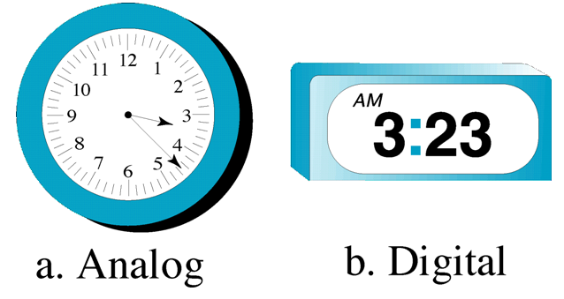
Analog and Digital Data
Data can be analog or digital. The term analog data refers to information that is continuous; digital data refers to information that has discrete states.
For example, an analog clock that has hour, minute, and second hands gives information in a continuous form; the movements of the hands are continuous. On the other hand, a digital clock that reports the hours and the minutes will change suddenly from 8:05 to 8:06.

Slide 3
Signal
A signal is formally defined as a function of one or more independent variables that conveys information on the nature of a physical phenomenon. Examples of independent variables are time, distance, position, temperature and pressure.
Example:
Speech and music signals represent air pressure as a function of time at point in space.
A black and white is a representation of light intensity as a function of two spatial coordinates.
The video signal in television consists of a sequence of images, called frames and is a function of three variables: two spatial coordinates and time.

Slide 4
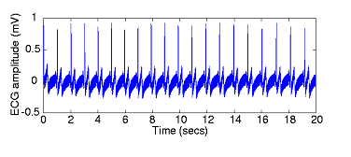
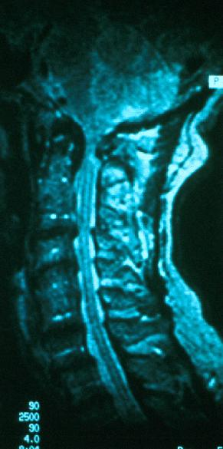
Types of independent variables
Time is often the independent variable. Example: Electrical activity of the heart recorded with the electrocardiogram (ECG).
The independent variable may be a spatial variable such as in image. Here grayscale information is specified as a function of position.
Figure: MRI (Magnetic Resonance Imaging)

Slide 5
Independent Variable Dimensionality
Signals are represented mathematically as functions of one or more independent variables. For example as speech signal can be represented mathematically by acoustic pressure as a function of time. Mathematically the signals is described as s=f(t), where s is the value of the signal and t is the independent variable. A picture can be represented by brightness as a function of two spatial variables (position). It can be mathematically written as z=f(x,y).

Slide 6

Analog and Digital Signal
Signals can be analog or digital. Analog signals can have an infinite number of values in a range; digital signals can have only a limited number of values.

Slide 7
Periodic and Nonperiodic (Aperiodic) Signals
A periodic signal completes a pattern within a measurable time frame, called a period, and repeats that pattern over subsequent identical periods. The completion of one full pattern is called a cycle.
A nonperiodic signal changes without exhibiting a pattern or cycle that repeats over time. Both analog and digital signals can be periodic or nonperiodic.

Slide 8
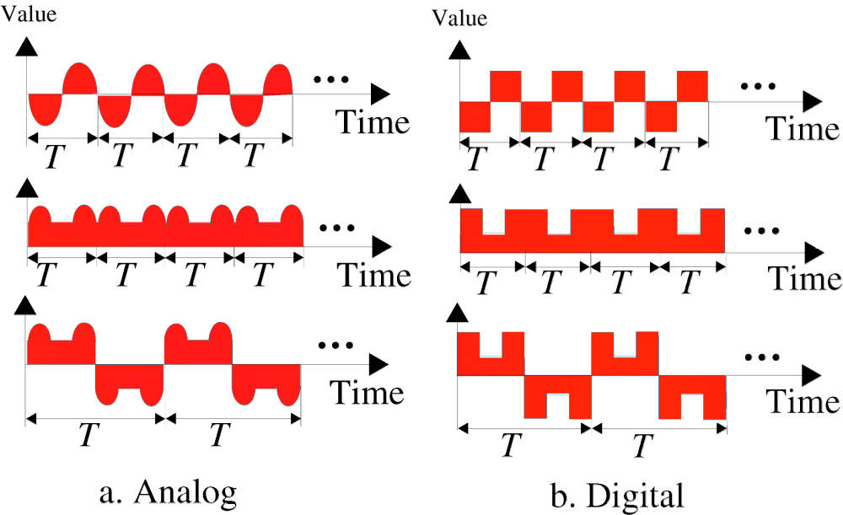
Periodic and Nonperiodic (Aperiodic) Signals Cont.
Figure: Periodic Signal

Slide 9
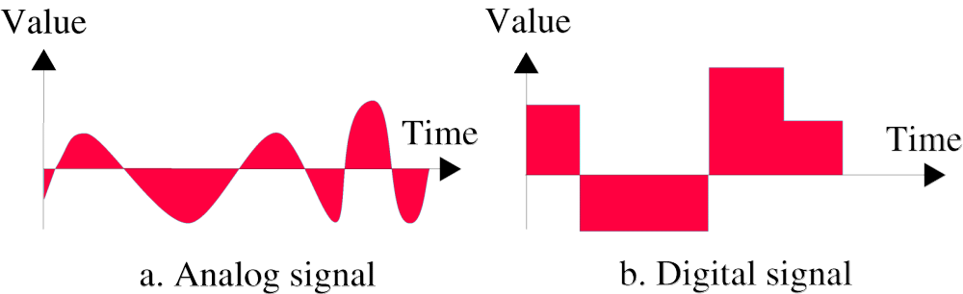
Periodic and Nonperiodic (Aperiodic) Signals Cont.
Figure: Aperiodic Signal

Slide 10

Periodic Analog Signals
Periodic analog signals can be classified as simple or composite. A simple periodic analog signal, a sine wave, cannot be decomposed into simpler signals. A composite periodic analog signal is composed of multiple sine waves.
Sine Wave:
A sine wave can be represented by three parameters: the peak amplitude, the frequency, and the phase. These three parameters fully describe a sine wave.

Slide 11

Periodic Analog Signals Cont.
Peak Amplitude
Periodic

Slide 12

Periodic Analog Signals Cont.
Frequency
Frequency is the rate of change with respect to time.
Change in a short span of time means high frequency.
Change over a long span of time means low frequency.
If a signal does not change at all, its frequency is zero
If a signal changes instantaneously, its frequency is infinite
Frequency and Period
Frequency and period are the inverse of each other.
Period refers to the amount of time, in seconds, a signal needs to complete 1 cycle. Frequency refers to the number of periods in 1s.

Slide 13

Periodic Analog Signals Cont.
Units of Period and Frequency

Slide 14

Periodic Analog Signals Cont.
Two signals with the same amplitude, but different frequencies
Period is formally expressed in seconds. Frequency is formally expressed in Hertz (Hz), which is cycle per second.

Slide 15


Periodic Analog Signals Cont.
Example
The power we use at home has a frequency of 60 Hz. What is the period of this sine wave?
The power we use at home has a frequency of 60 Hz. What is the period of this sine wave?
Example
The period of a signal is 100 ms. What is its frequency in kilohertz?

Slide 16
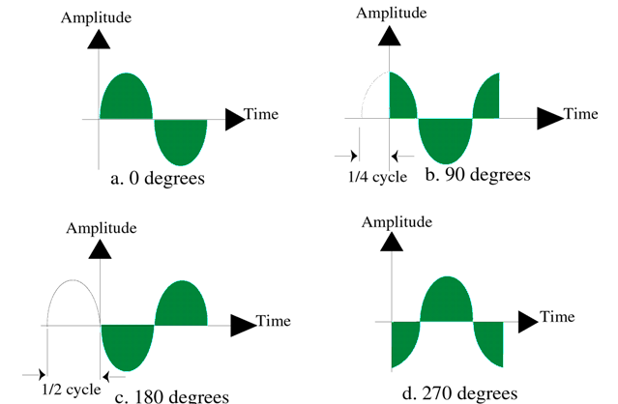
Periodic Analog Signals Cont.
Phase
Phase describes the position of the waveform relative to time 0.
A phase shift of 360° corresponds to a shift of a complete period; a phase shift of 180° corresponds to a shift of one-half of a period; and a phase shift of 90° corresponds to a shift of one-quarter of a period.

Slide 17

Periodic Analog Signals Cont.
Three sine waves with the same amplitude and frequency, but different phases

Slide 18

Periodic Analog Signals Cont.
Example
A sine wave is offset 1/6 cycle with respect to time 0. What is its phase in degrees and radians?
Solution
We know that 1 complete cycle is 360°. Therefore, 1/6 cycle is

